Slide 1



Computer Organization and Architecture
Div C SY COMP
Sem III
AY 2024-25

Slide 2



Computer Organization and Architecture
Course Outcomes
At the end of successful completion of the course the student will be able to
CO 1. Describe and define the structure of a computer with buses
structure and detail working of the arithmetic logic unit and its sub modules
CO 2. Understand the Central processing unit with addressing modes and working of control unit in depth
CO 3. Learn and evaluate memory organization and cache structure
CO 4. Summarize Input output techniques and multiprocessor configurations

Slide 3
Module 2
Arithmetic and Logic Unit 2.1
Introduction to Arithmetic and Logical unit, Computer Arithmetic: Fixed and Floating point numbers, Signed numbers, Integer Arithmetic, 2’s Complement arithmetic
2.2
Booth’s Recoding and Booth’s algorithm for signed multiplication, Restoring division and non-restoring division algorithms
2.3
IEEE ﬂoating point number representation and operations: Addition. Subtraction, Multiplication and Division. IEEE standards for Floating point representations :Single Precision and Double precision Format

Slide 4
Introduction to Arithmetic and Logical unit,
Search for ALU diagram
Find which are the signal interface for ALU
Find which are components inside ALU

Slide 5
Introduction to Arithmetic and Logical unit,
Search for ALU diagram
Find which are the signal interface for ALU
Find which are components inside ALU
Do the calculations
Everything else in the computer is there to service this unit
Handles integers
May handle ﬂoating point (real) numbers
May be separate FPU (maths co-processor)

Slide 6
Computer Arithmetic
Number System : Binary Numbers
Fixed Numbers (Unsigned numbers )
n bit Binary : 0 to 2n -1...total 2n values
4 bit binary : 0 to 15 ( 24 -1)...total 16 values
Signed Numbers
n bit Binary : 2n values, half values negative, half positive MSB reserved for indication of Sign
0 - positive , 1 - negative
1’s Complement
2’s Complement
Floating Point Numbers
Short Real
Long Real

Slide 7
Signed Number Representation
1’s complement Representation
Complement of binary number ,
0100 1011
sign bit

Slide 8
Signed Number Representation
1’s complement Representation
Binary Value | Unsigned | Signed 1’s complement
000 | 0 | 0
001 | 1 | 1
010 | 2 | 2
0 1 1 | 3 | 3
100 | 4 | -3
1 01 | 5 | -2
1 10 | 6 | -1
1 1 1 | 7 | -0

Slide 9
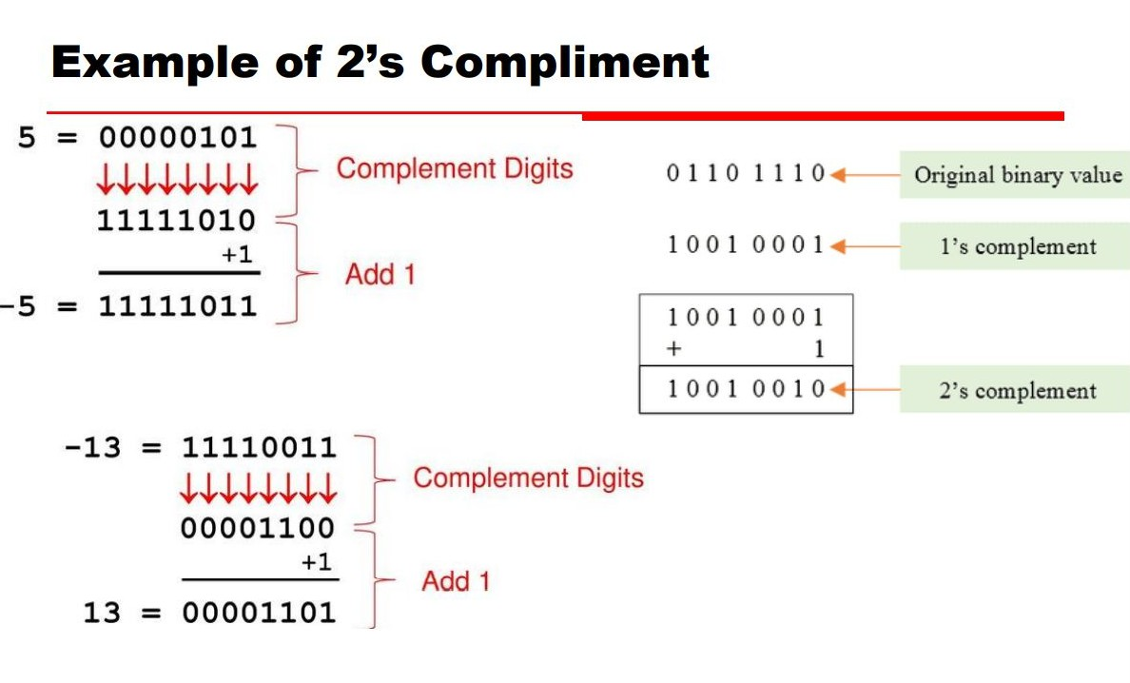
Signed Number Representation
2’s complement Representation
2’s complement = complement of a number + 1
Add 1 to 1’s complement
1011 +1 = 1100
Sign Bit

Slide 10
Signed Number Representation
Find 2’s complement Representation and its value
1000
0100
111001
101010
100000

Slide 11
Signed Number Representation
2’s complement Representation
Binary | Unsigned | Signed 1’s complement | Signed 2’s complement
000 | 0 | 0 | 0
001 | 1 | 1 | 1
010 | 2 | 2 | 2
0 1 1 | 3 | 3 | 3
100 | 4 | -3 | -4
1 01 | 5 | -2 | -3
1 10 | 6 | -1 | -2
1 1 1 | 7 | -0 | -1

Slide 12
Signed Number Representation
Signed and Unsigned Numbers
“n” bit number represents 2^{n} values
unsigned numbers are from 0 to 2^{n} - 1
in 2’s complement signed number representation it ranges from -2^{(n-1)} to +2^{(n-1)}-1
for example if n = 4, there are 16 values
Unsigned numbers are from 0 to 15
2’s complement signed numbers are from -8 to +7
What for n= 8? - 2^7 to + 2^7-1
- 128 to 127….256 values

Slide 13
Floating Point Number Representation
Numbers having integer and fractional part are represented by indicating number in mantissa and exponent form
32 bit : Short Real Number
64 bit : Long Real Number

Slide 14
Integer Arithmetic
Addition and Subtraction
Normal binary addition
Monitor sign bit for overﬂow
Take two’s complement of subtrahend and add to minuend
i.e. a - b = a + (-b)
A | B | Sum | carry | Difference | Borrow
0 | 0 | 0 | 0 | 0 | 0
0 | 1 | 1 | 0 | 1 | 1
1 | 0 | 1 | 0 | 1 | 0
1 | 1 | 0 | 1 | 0 | 0

Slide 15
Integer Arithmetic
Addition and Subtraction : Unsigned
 | D3 | D2 | D1 | D0
 | 1 | 0 | 0 | 1
 | 0 | 0 | 1 | 1
 | D3 | D2 | D1 | D0
 | 1 | 0 | 0 | 1
 | 0 | 0 | 1 | 1
 | D3 | D2 | D1 | D0
 | 0 | 0 | 0 | 1
 | 1 | 0 | 1 | 1

Slide 16
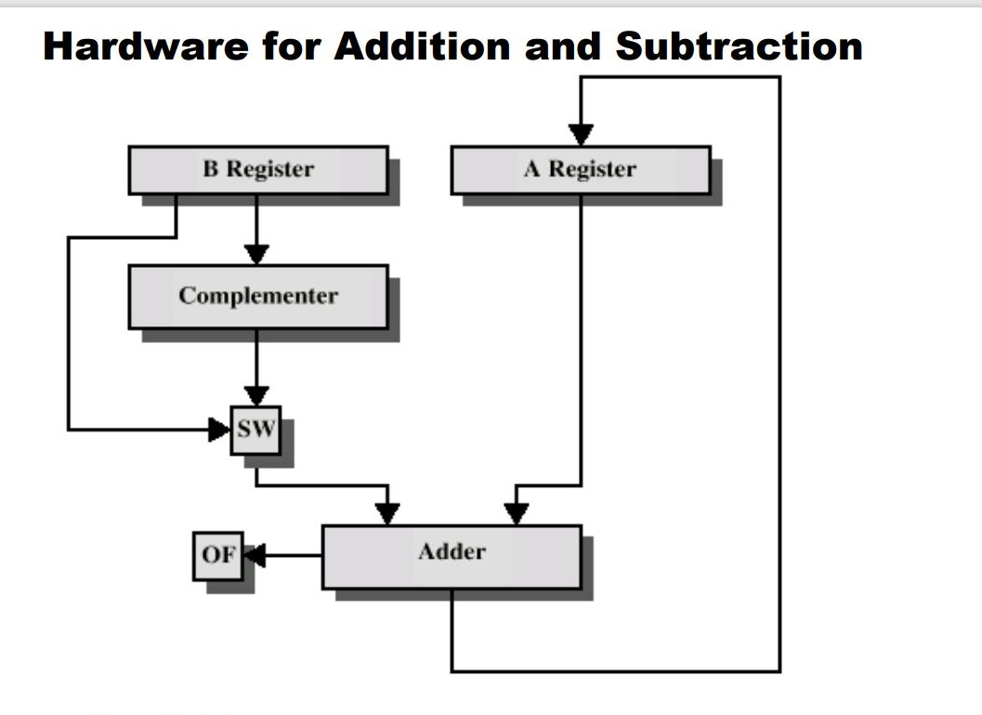
Integer Arithmetic

Slide 17
Integer Arithmetic
Addition and Subtraction : Signed
 | D3 | D2 | D1 | D0
 | 1 | 0 | 0 | 1
 | 0 | 0 | 1 | 1
 | D3 | D2 | D1 | D0
 | 1 | 0 | 0 | 1
 | 0 | 0 | 1 | 1
 | D3 | D2 | D1 | D0
 | 0 | 0 | 0 | 1
 | 1 | 0 | 1 | 1

Slide 18
2’s Complement Arithmetic
Subtraction using 2’s Complement 7 - 12
7 = 00111
12 = 01100
-12 = 10100
 | D4 | D3 | D2 | D1 | D0
 | 0 | 0 | 1 | 1 | 1
 | 1 | 0 | 1 | 0 | 0
Since no carry ...it is a negative result , find 2’s complement to get value = 00101 =-5

Slide 19
2’s Complement Arithmetic
Subtraction using 2’s Complement 13 - 9
13 = 01101
9 = 01001
-9= 10111
13 - 9 = 13 + ( -9)
 | D4 | D3 | D2 | D1 | D0
 | 0 | 1 | 1 | 0 | 1
 | 1 | 0 | 1 | 1 | 1
Since there is carry ...it is a positive result , = 4

Slide 20
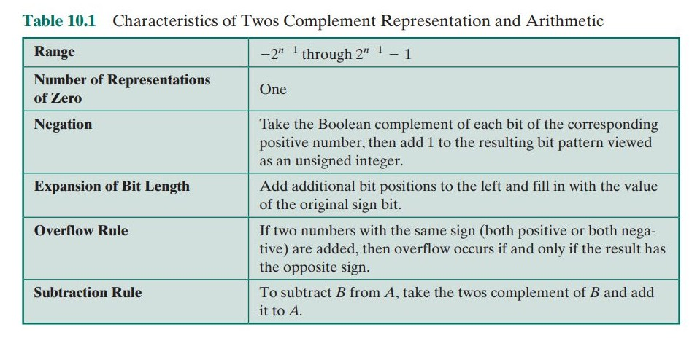
2’s Complement Arithmetic

Slide 21
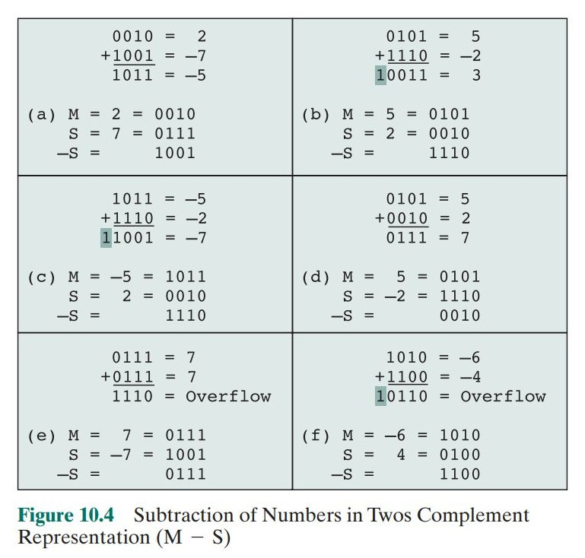
2’s Complement Arithmetic

Slide 22
Integer Multiplication
N X N bit multiplication produces 2N bit result
A | B | Product
00 | XX | 00
01 | 01 | 01
01 | 10 | 10
01 | 11 | 11
10 | 01 | 10
10 | 10 | 100
10 | 11 | 110
11 | 01 | 11
11 | 10 | 110
11 | 11 | 1001
A | B | Product
0 | 0 | 0
0 | 1 | 0
1 | 0 | 0
1 | 1 | 1

Slide 23
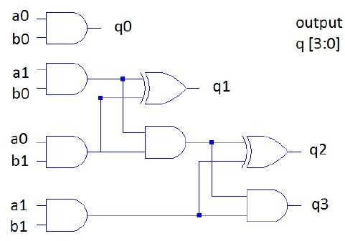
2 bit Multiplier
 |  | A1 | Ao
 | X | B1 | B0
 |  |  | A0B0
 |  | A1B0
 |  | B1A0
 | A1B1
Cy | Cy
Q3 | Q2 | Q1 | Q0

Slide 24
Integer Multiplication
Basic 1 Bit Multiplier : AND operation
AND Gate
Multibit Multiplication
Array of AND gates and Adders
Propagation of carry : delay incurred
Shift and Add Multiplier
Efficient Arithmetic Circuits: Adder / Multiplier

Slide 25
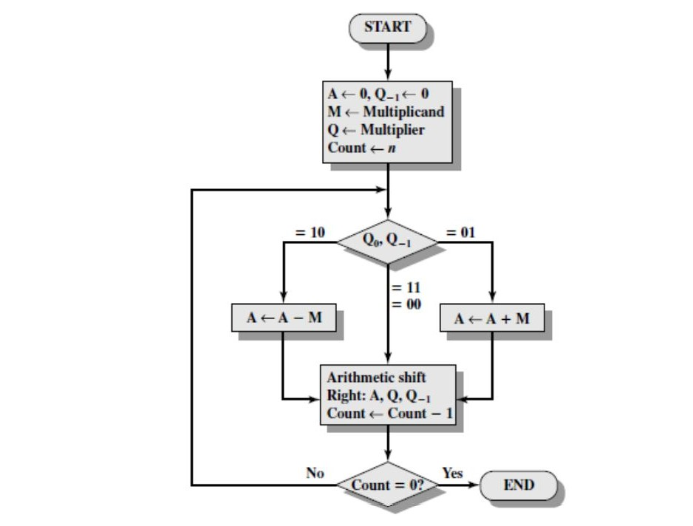
Booth Multiplier
Q0 | Q-1 | Action
0 | 0 | Only Shift
1 | 1
0 | 1 | A = A+M, Shift
1 | 0 | A = A-M , Shift

Slide 26
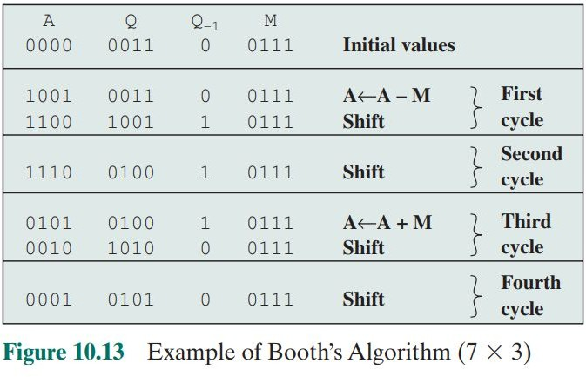
Booth Multiplier

Slide 27
Booth Multiplier : 13x 7
A | Q | Q-1 | M | Count | Remarks
00000 | 00111 | 0 | 01101 | 5 | Initial phase
 |  |  |  |  | A<=A-M

Slide 28
Booth Bit pair Recoding
Multiplier Bit Pair i+1 i |  | Multiplier bit on the right i-1 | Multiplicand selected at position i
0 | 0 | 0 | 0
0 | 0 | 1 | 1
0 | 1 | 0 | 1
0 | 1 | 1 | 2
1 | 0 | 0 | -2
1 | 0 | 1 | -1
1 | 1 | 0 | -1
1 | 1 | 1 | 0

Slide 29
Booth Bit pair Recoding
13 X -11
Multiplicand 13
Multiplier -11
0 1 1 0 1
1 0 1 0 1
For Booth coding 0 appended and 1 is sign extension for Bit pair coding)
Booth coded Multiplier, Pairs underlined for Bit pair coding
Bit pair coded multiplier
Multiplicand x -1 = 13 x -1 = 1 1 0 0 1 1
0 1 1 0 1
-1_+1 _+1
--------------
0 1 1 0 1
0 1 1 0 1 0 0
1 1 0 1 0 1 0
0 -1 +1 -1 +1 -1
-1 1 1
1 1 0 0 1 1 0 0 0 0
1 1 0 1 1 1 0 0 0 1

